Slide 1
CONTROL TOWER
USER MANUAL
Supplier

Slide 2
SUPPLIER
Main Sessions
PO Acceptance
Create Quality Inspection List
Link Inspection List with Inspection Request
Convert Cleared QI List to Packing List for Despatch
Create Packing List for Despatch
Raise Vehicle Placement Request from Packing List
Link Packing List with Vehicle Request & Despatch

Slide 3
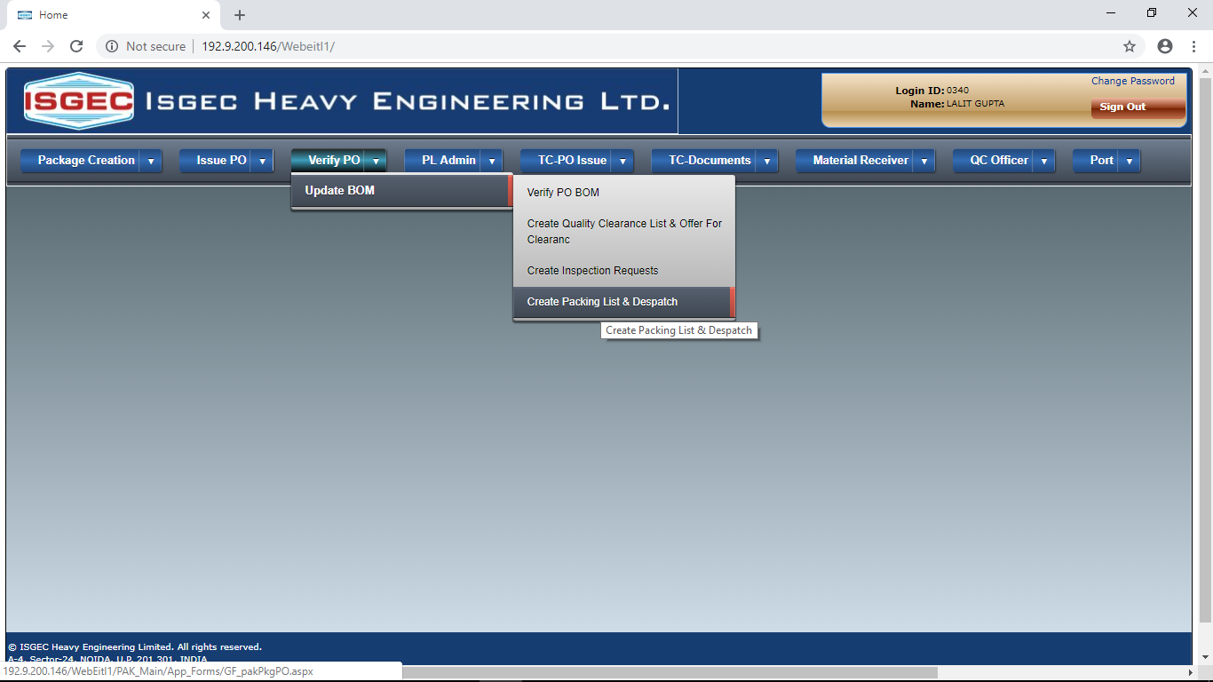
PO Acceptance
To Accept PO, go to either Create Inspection List OR Create Packing List Session

Slide 4
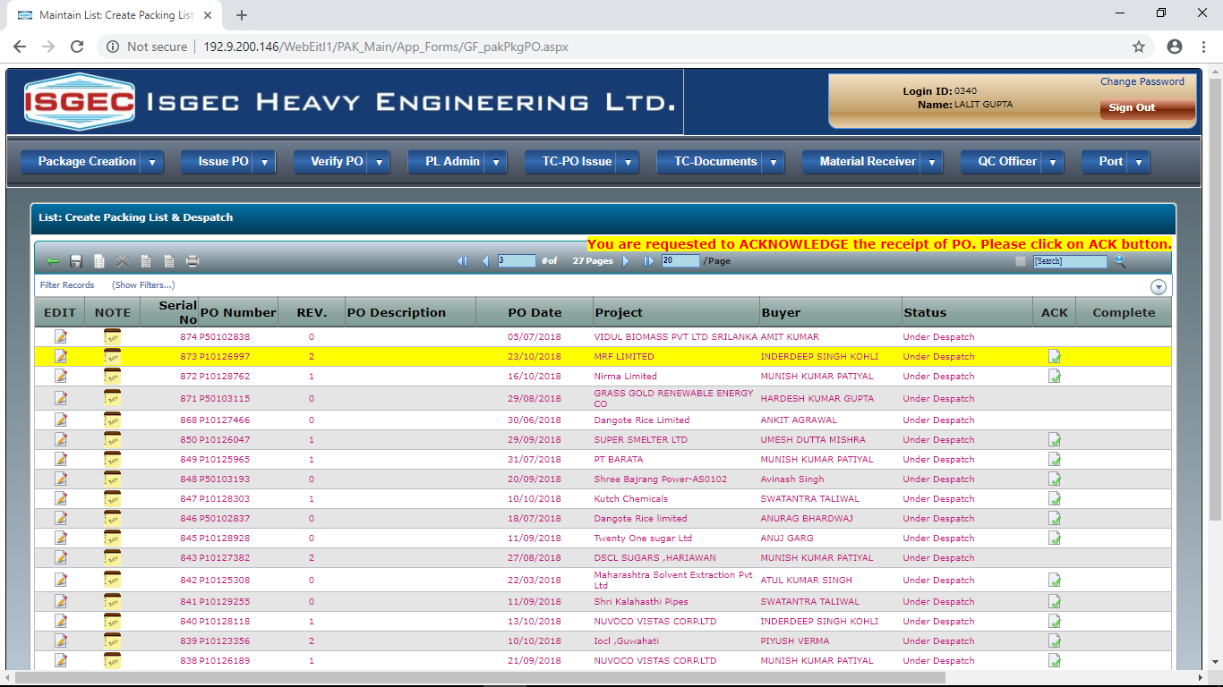
It will show the List of PO issued to Supplier
Click on Acknowledge button to Accept PO.

Slide 5
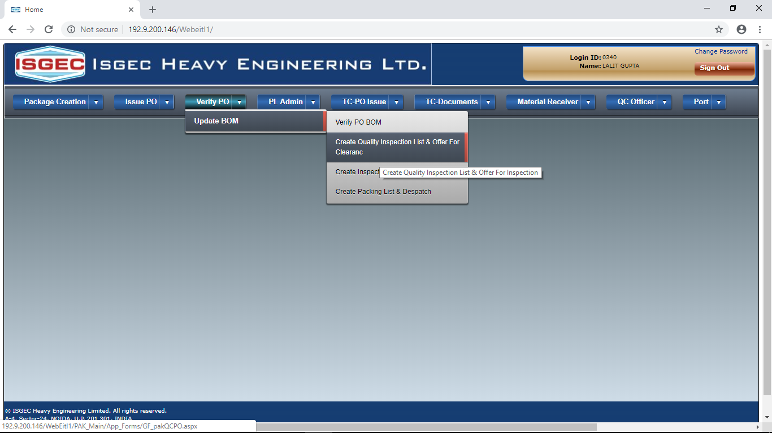
Create Quality Inspection List
Go to Create Quality Inspection List Menu Option

Slide 6
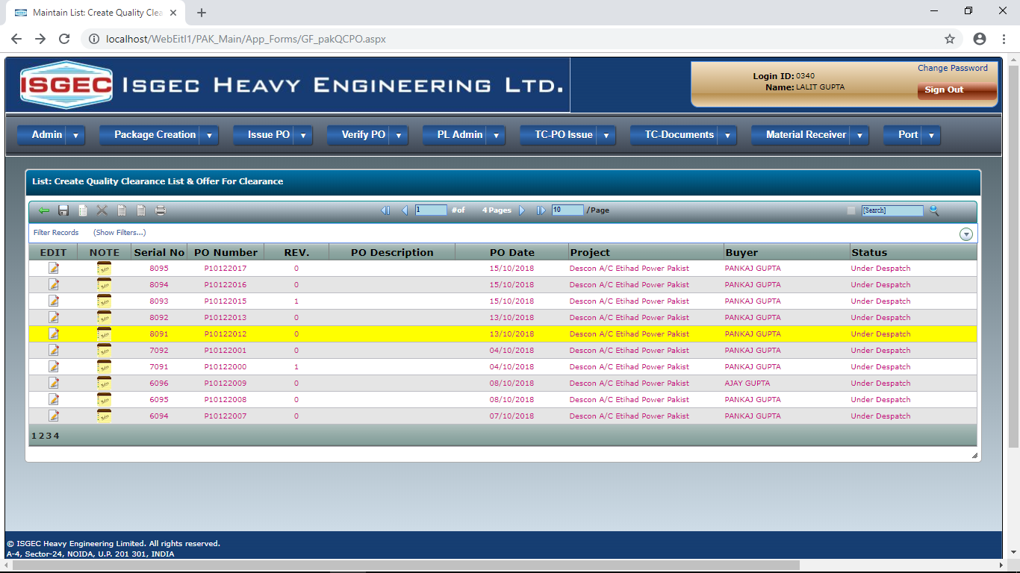
It will show list of PO issued to Supplier.
Select the PO in which Inspection Request is to be created and click on EDIT button.

Slide 7
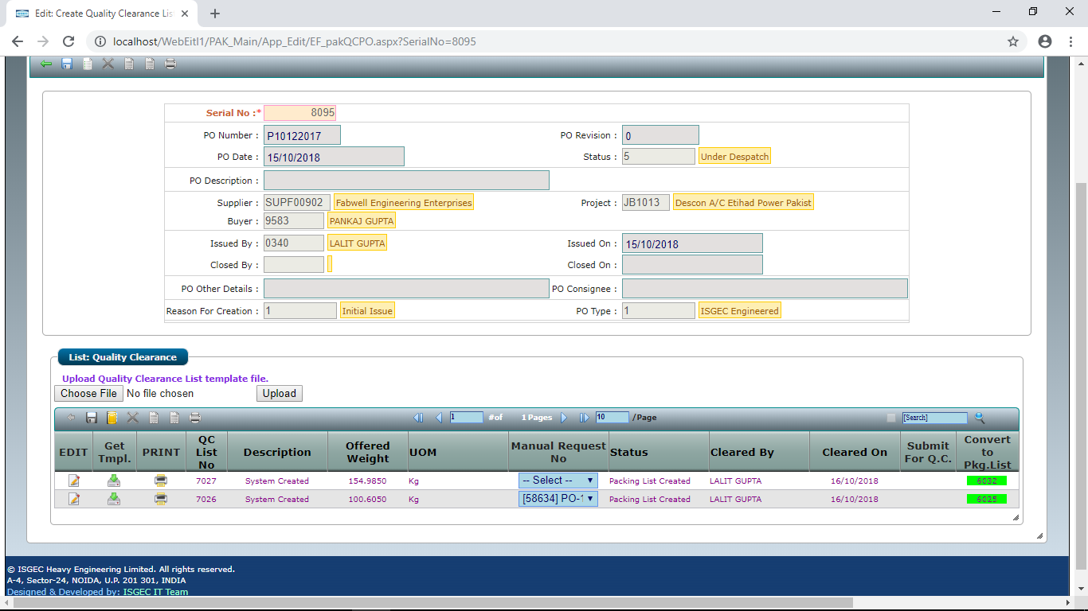
It will show the PO details and a List of already created Inspection List.
Click on the NEW button to create new Inspection List to offer for Inspection.

Slide 8
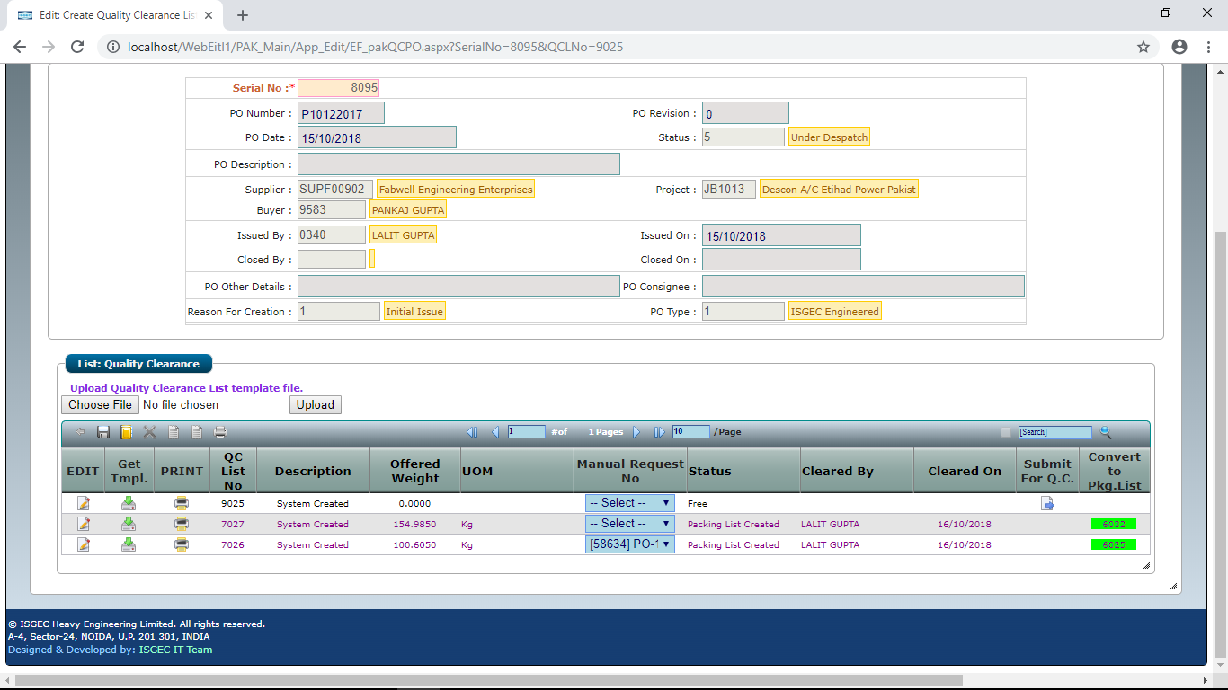
A New Offer Record is created and will appear on top of the list. To select Items in this Offer Click on Get Template button.

Slide 9
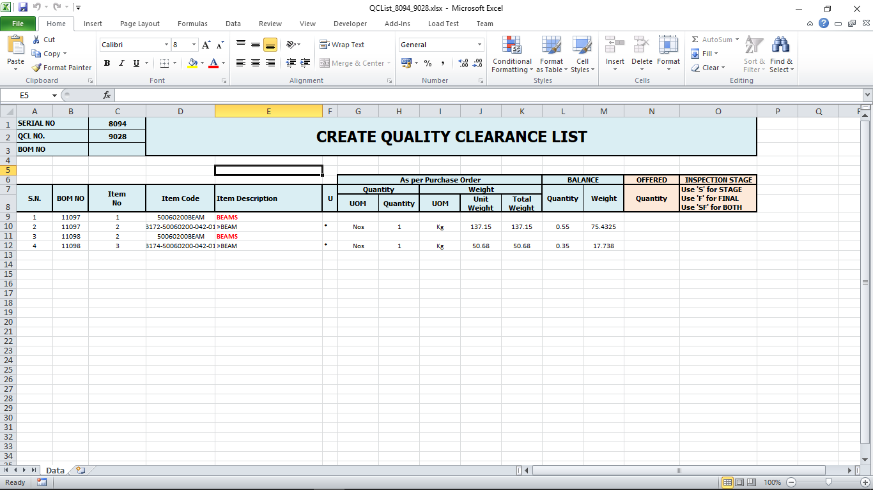
Enter Offered Quantity and Stage/Final against Items to be Inspected. [Do not enter any thing against Items you do not want to offer]
An MS Excel file will be downloaded, save and Open the Excel File. It contains all child Items of PO

Slide 10
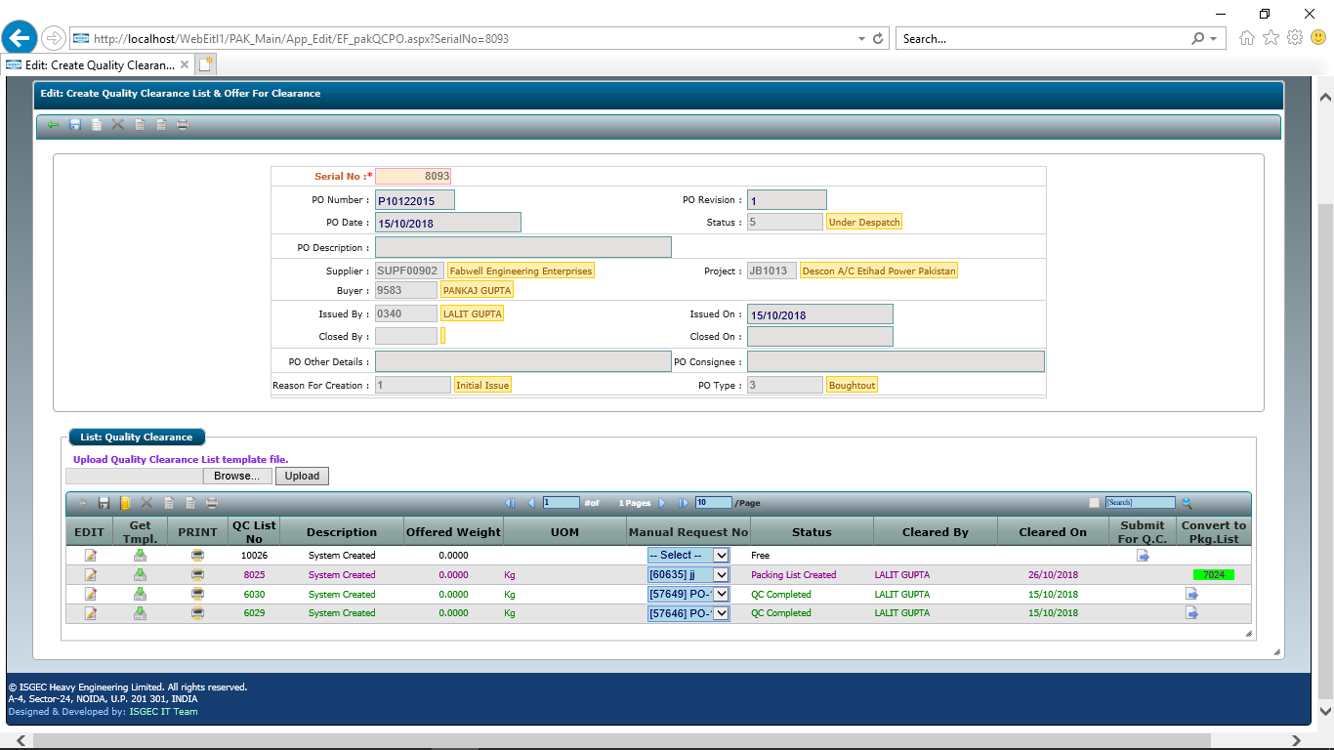
Save the Excel and upload It
Click on Browse/Search button to locate Excel file and click on Upload Button.

Slide 11
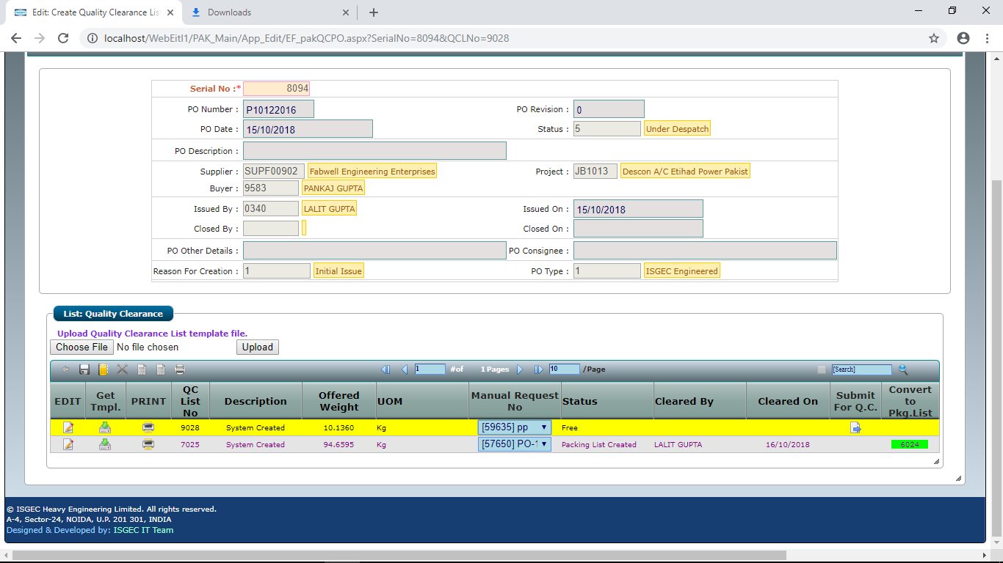
Link Inspection List with Inspection Request
Select the Inspection Request from drop down to link Request with Offer

Slide 12
Click on Submit For QC Button to Offer for Inspection.

Slide 13

Convert Cleared QI List to Packing List for Despatch
After Inspection Supplier have an OPTION to convert Cleared Items to Packing List for Directly.
Alternatively Supplier can create Packing List from Packing List Session.
Click on Convert to Packing List Button, it will show the created Packing List No.

Slide 14
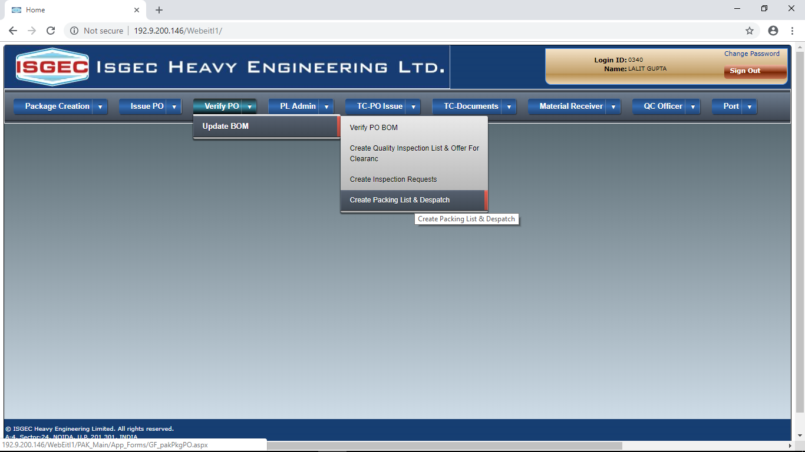
Create Packing List for Despatch
Click on Create Packing List & Despatch Menu Option.

Slide 15
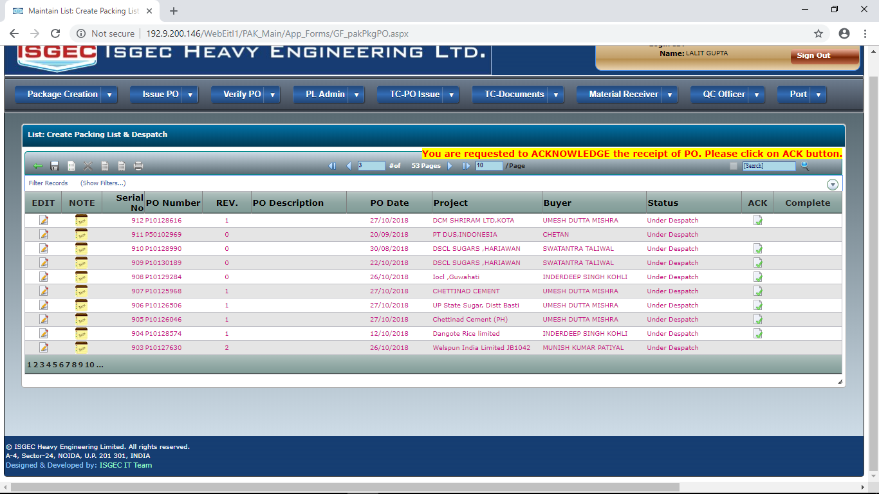
It will show List of PO issued to supplier.
Click on the EDIT Button to select the Purchase Order.

Slide 16
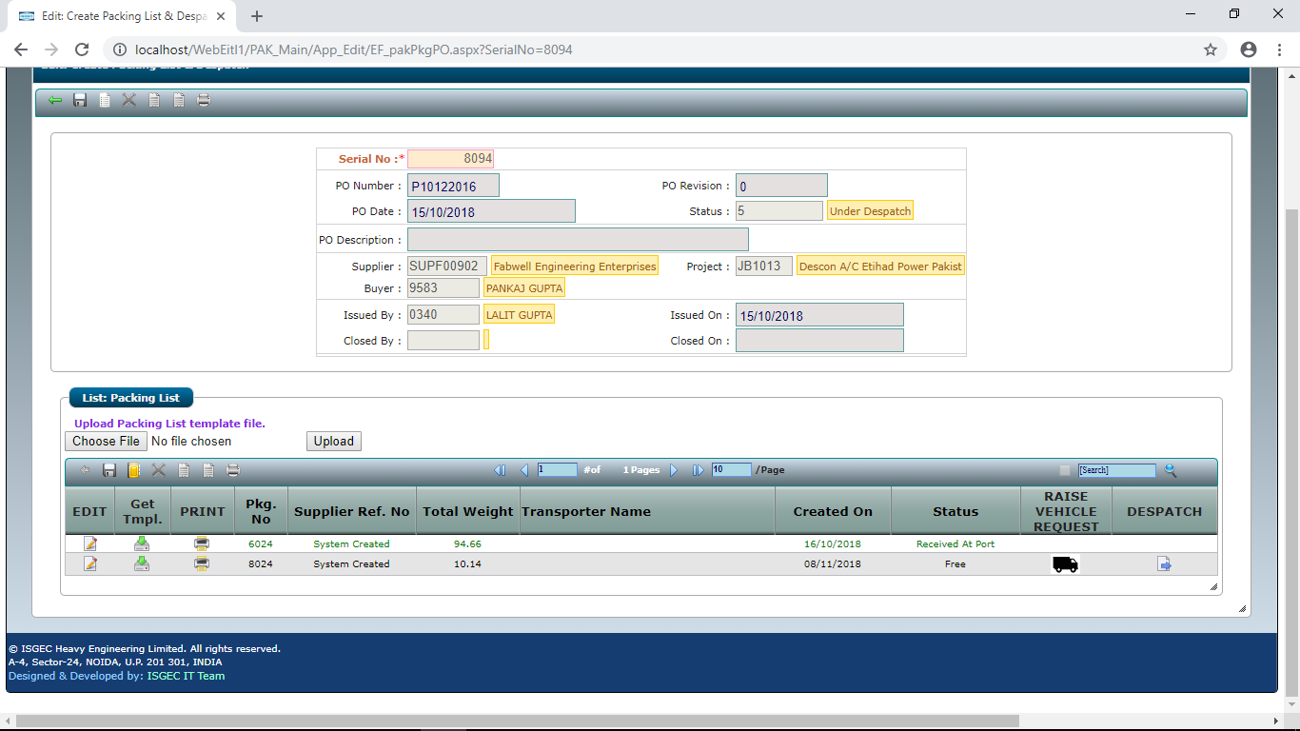
It will show PO Details and List of already created Packing List
Click on New Button to create Packing List.

Slide 17
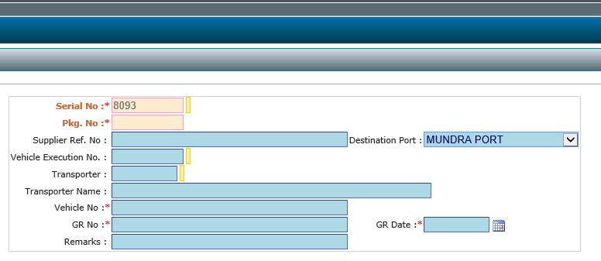
Fill the required details and save the form.
Vehicle No, GR No, GR Date are mandatory.

Slide 18
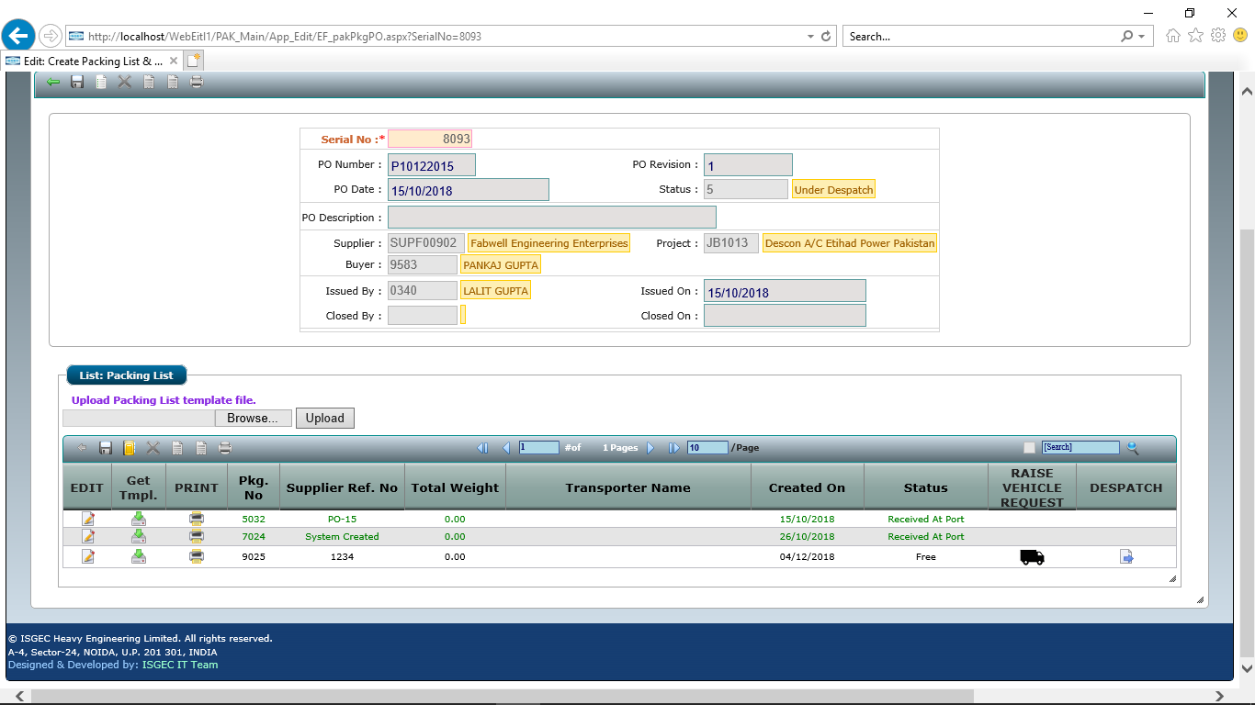
A new Packing List record will be created.
Click on Download template button. An Excel file will be downloaded. Save & Open the file.

Slide 19
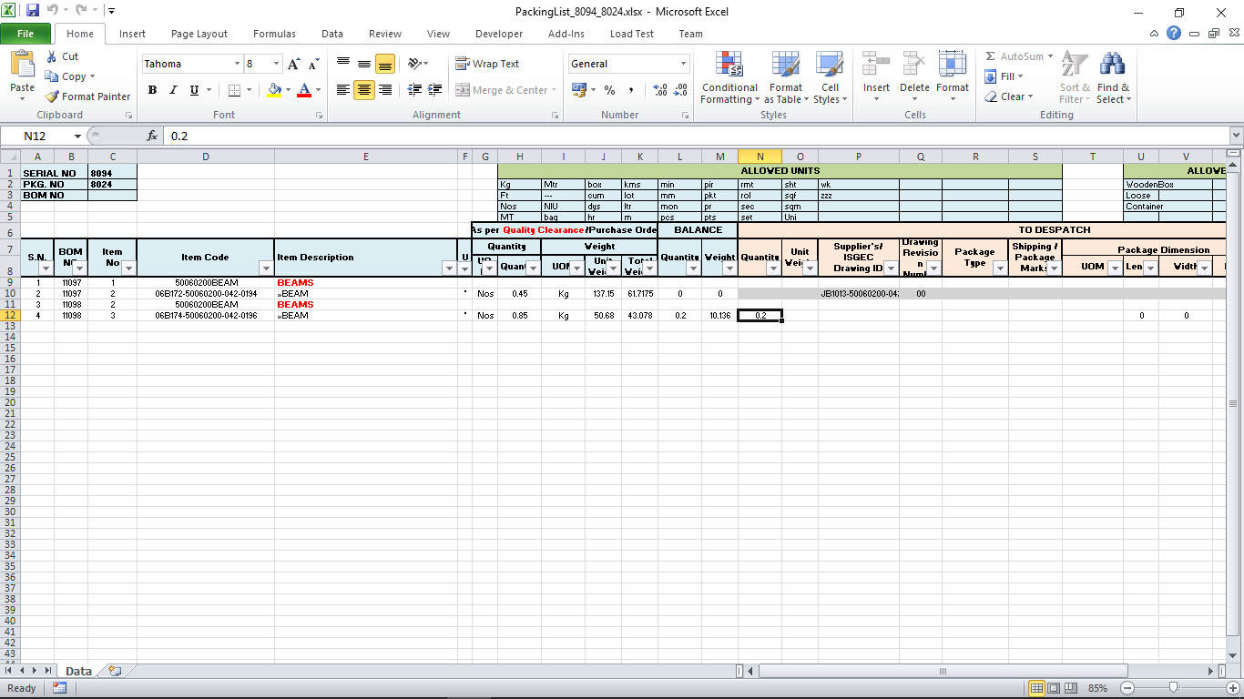
It will show all Quality Cleared Item List with Balance to Despatch Quantity.
Enter Quantity against Items to be despatched. Do not write anything against Items you do not want to despatch.
If Items are Packed in Boxes, fill the Package details against those Items. [List of allowed Package Type and Unit of Measurement is given at top, use from allowed list only.]

Slide 20
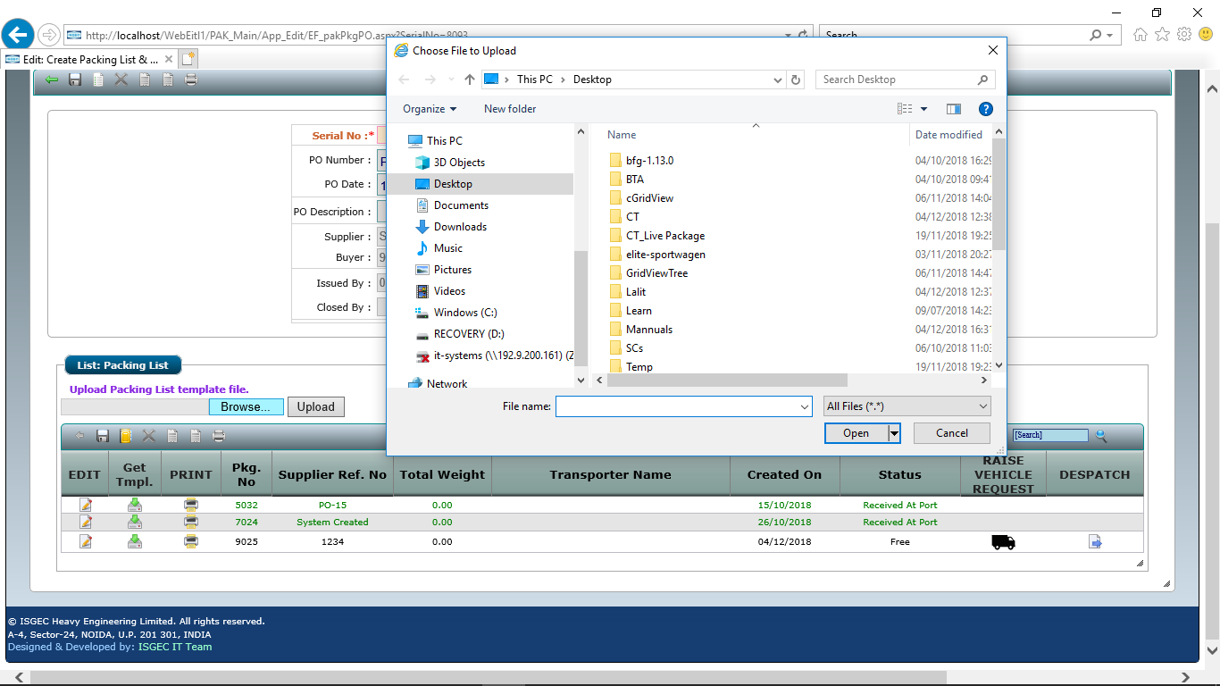
Save and Upload the Excel File.
Click on Search/Browse Button to locate the Excel file, then Click on Upload Button.

Slide 21
Raise Vehicle Placement Request from Packing List
Supplier have an option to Raise Vehicle Request on ISGEC for Packing List.
Click on Raise Vehicle Request Button

Slide 22
Edit the Packing List Record before despatch.
Click on the EDIT Button.

Slide 23
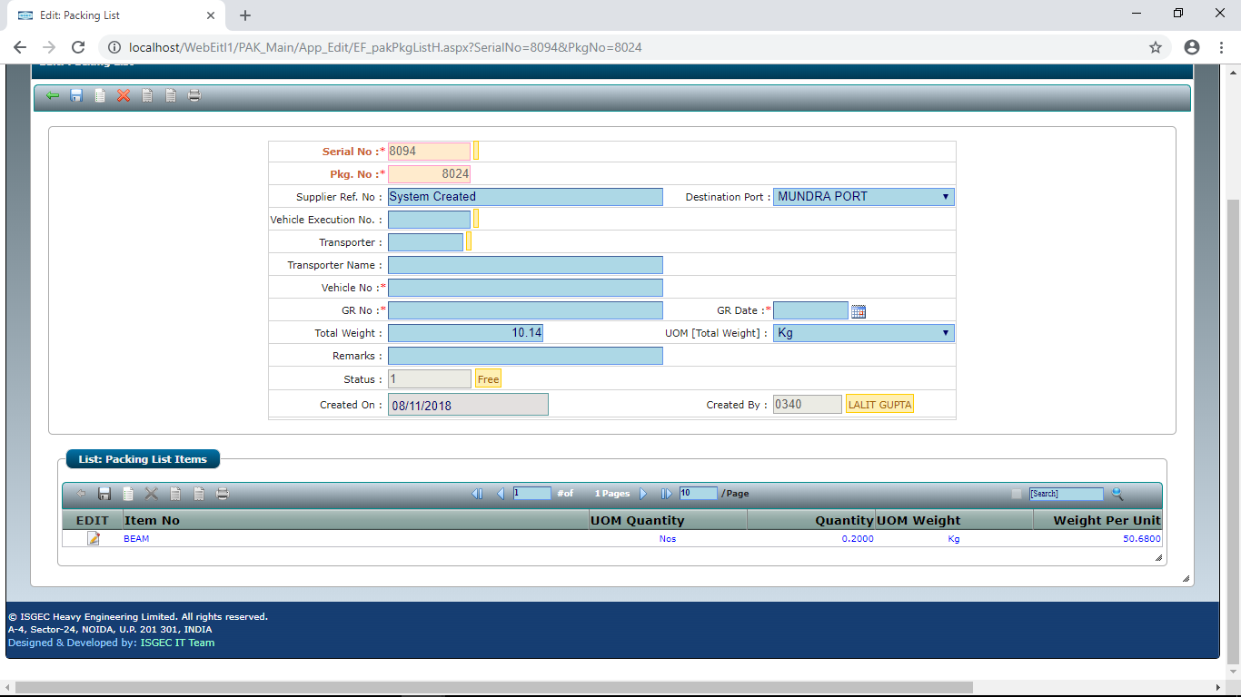
Link Packing List with Vehicle Request & Despatch
Before despatch Edit Packing List Record.
Press any key in Vehicle Execution No. Field to see Vehicle Request select the relevant Request, Transporter Code will automatically filled. Update other fields and SAVE the record.

Slide 24
Click on Despatch Button to despatch the Material and lock the Packing List from Modification.

Slide 25
END

